Slide 1
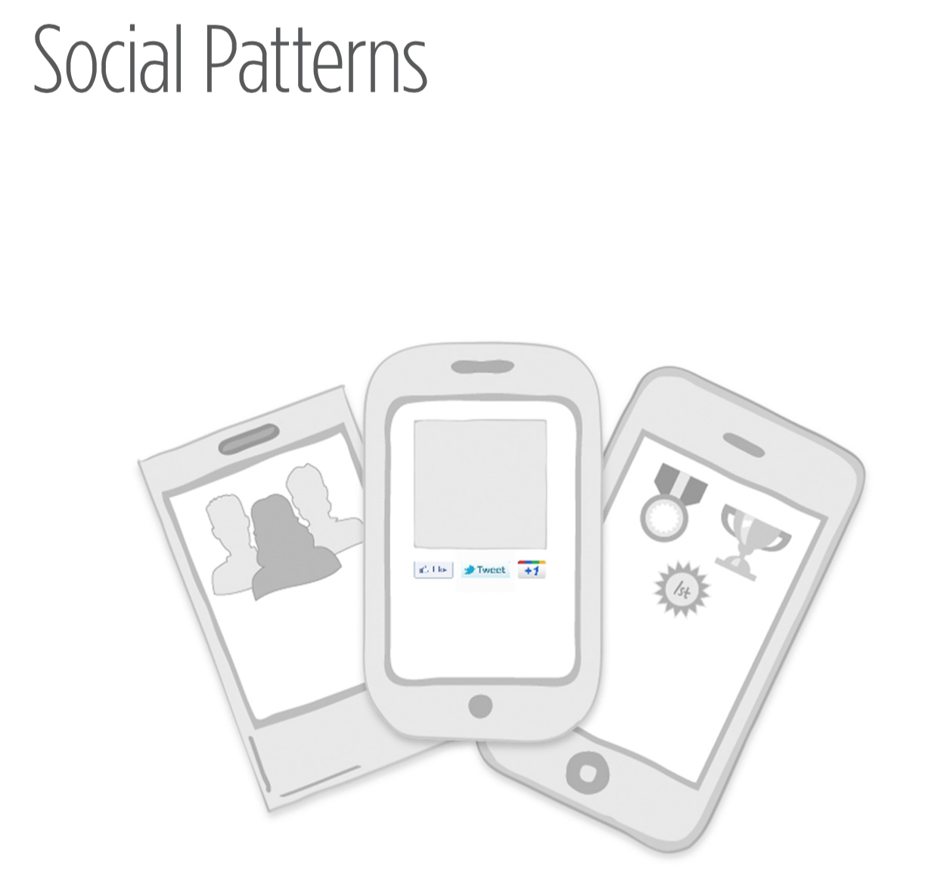
Notes:
Services that provide social connections have continued to proliferate and specialize. Now we can connect with other people through our shared affinities for food, shopping, fitness, and much more. In this new chapter, we’ll examine patterns that can help your users make these connections through their mobile devices.

Slide 2
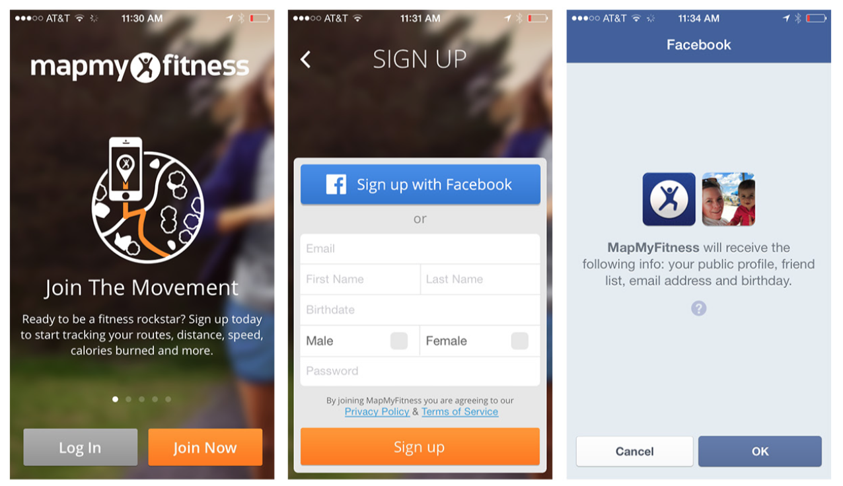
Notes:
FIGURE 8-1.
MapMyFitness for iOS streamlines Registration with Facebook and an op- tional personalization screen
MapMyFitness Compared to We Heart It
MapMyFitness offers Sign Up with Facebook, and uses the Facebook API to show a single authorization screen. If authorized, it pulls per- tinent registration information from your Facebook profile to create your MapMyFitness profile for you.

Slide 3
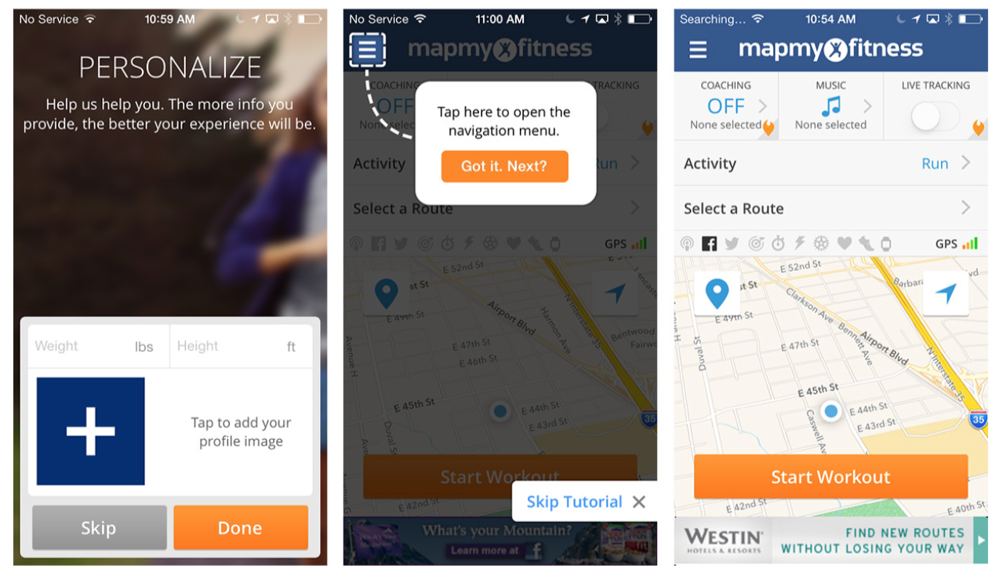
Notes:
FIGURE 8-1.
MapMyFitness for iOS streamlines Registration with Facebook and an op- tional personalization screen

Slide 4
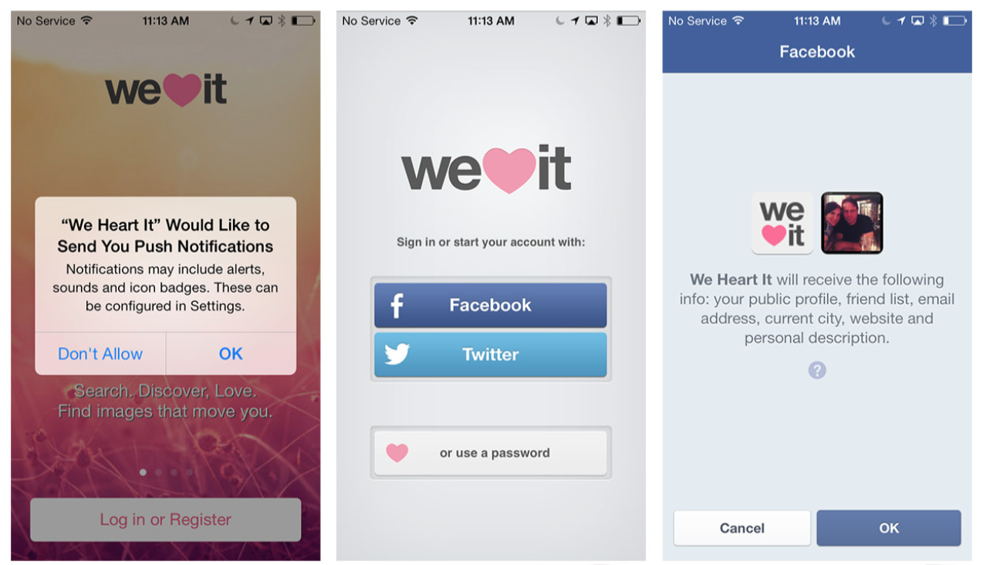
Notes:
FIGURE 8-2.
We Heart It for iOS: I don’t “heart” all of these authorization screens and errors
Unfortunately, We Heart It, like many apps, has implemented the Facebook API incorrectly. After I authorized the use of my Facebook identity to register, it asked me to sign in to Facebook (I already had), and only then told me that if I wanted to use Facebook to register, I needed to adjust my Safari settings. What the heck? And to top it off, there was a bug: I was presented the option to “skip posting to Facebook” multiple times in a row. It’s these kinds of confusing extra steps and glitches that cause user frustration and abandonment.

Slide 5
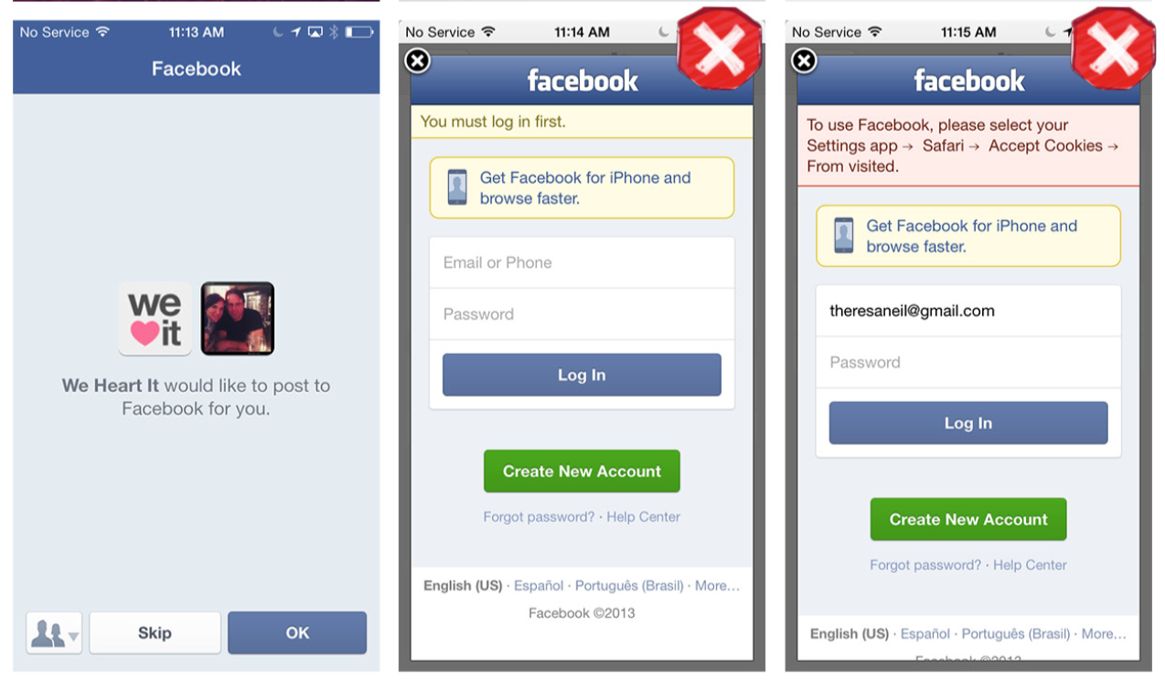
Notes:
FIGURE 8-2.
We Heart It for iOS: I don’t “heart” all of these authorization screens and errors
Use social network APIs properly to streamline the Registration experience. Make sure to perform quality assurance testing on all paths of the Registration flow.

Slide 6
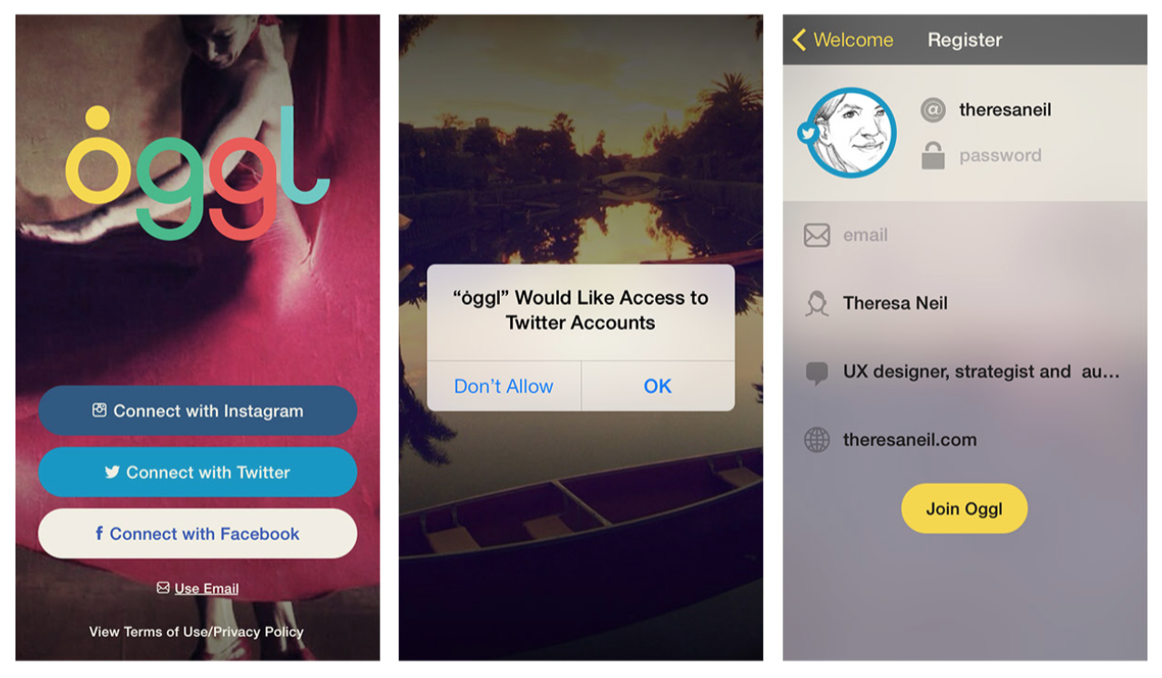
Notes:
FIGURE 8-3.
Oggl for iOS: adding connections from other social networks as an optional flow in Registration
Part of the beauty of using APIs for other social platforms is that it lets users access their existing social connections. Oggl offers a simple connection flow as an optional part of the Registration process. In this example, I registered using my Twitter account, and then Oggl created a prefilled profile for me; I only needed to add a password and email address. A couple of taps later, I was able to connect with everyone I follow on Instagram, Twitter, and Facebook.

Slide 7
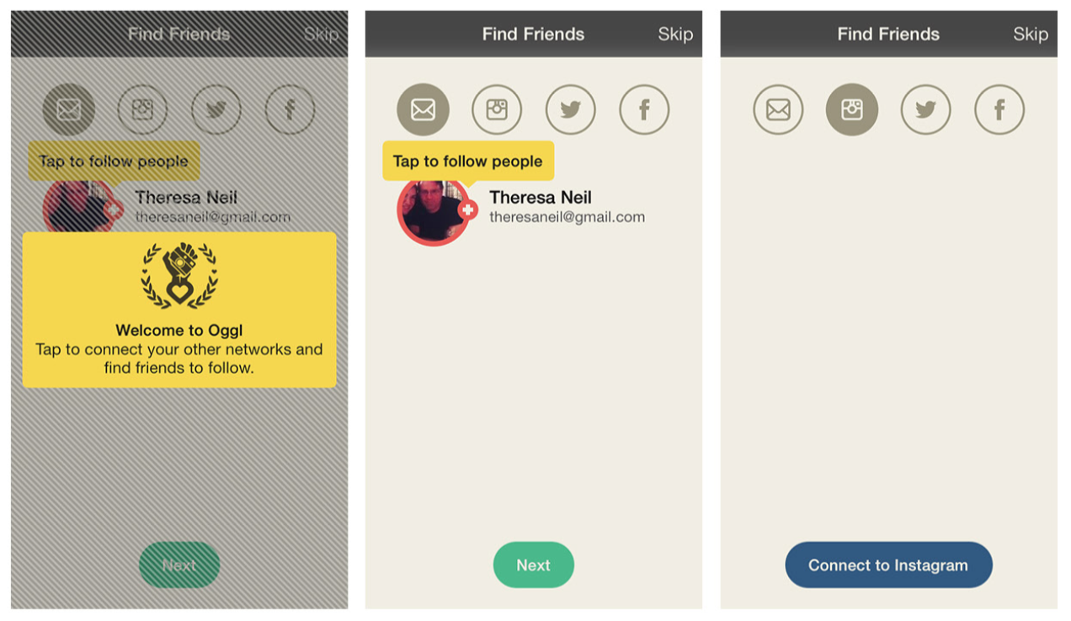
Notes:
FIGURE 8-3.
Oggl for iOS: adding connections from other social networks as an optional flow in Registration

Slide 8
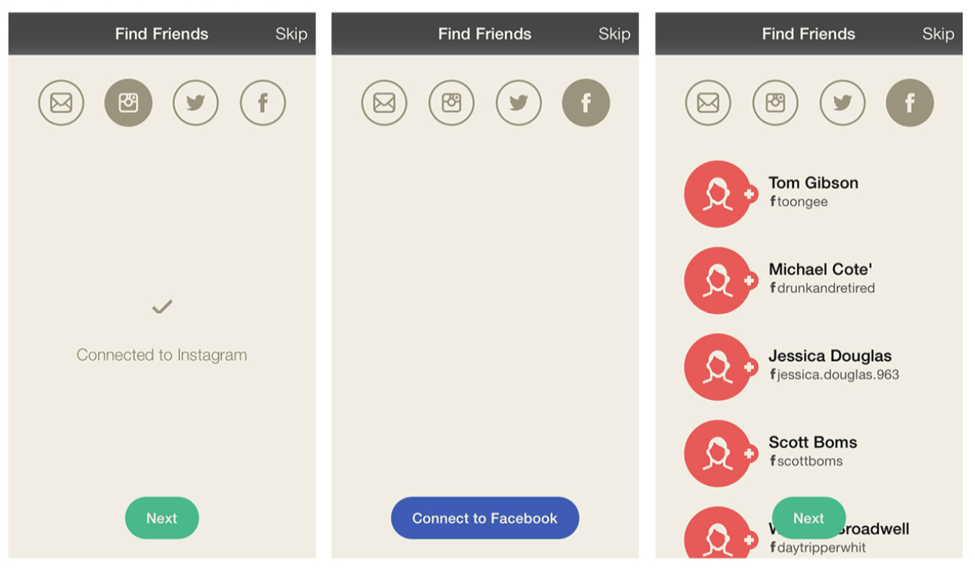
Notes:
FIGURE 8-3.
Oggl for iOS: adding connections from other social networks as an optional flow in Registration

Slide 9
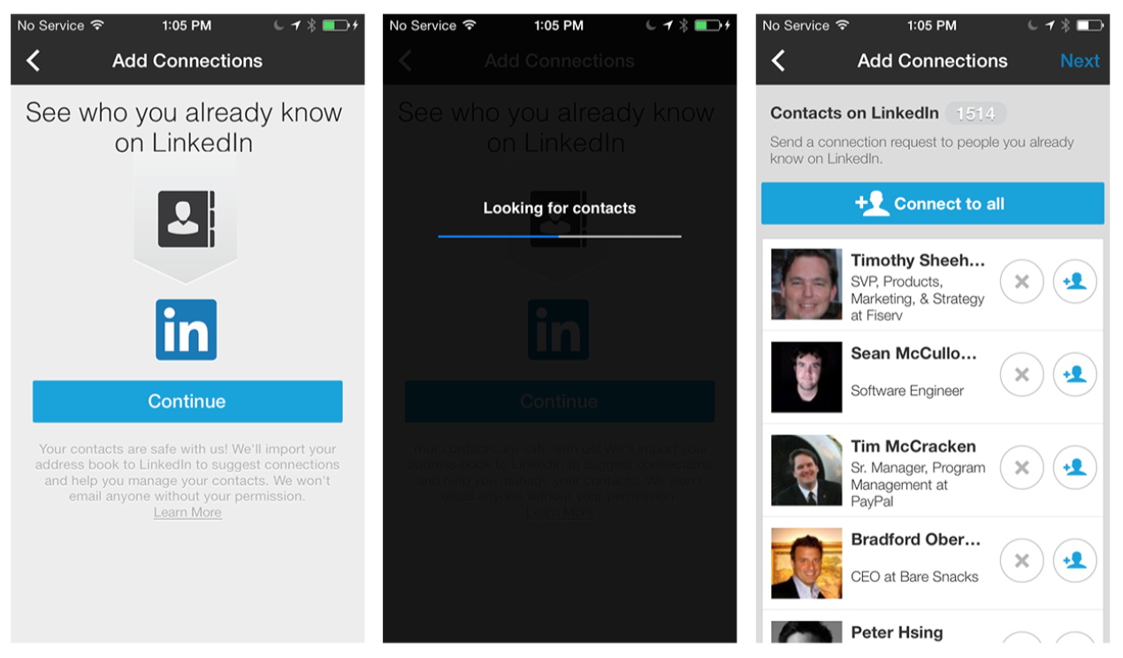
Notes:
FIGURE 8-4.
LinkedIn for iOS: accepting a connection serves up suggestions for others to connect with
LinkedIn has introduced a new flow in its web and mobile apps that has had a significant impact on driving additional connections. Any time you accept an invite, there is a full-screen prompt to “See who you already know on LinkedIn.”

Slide 10
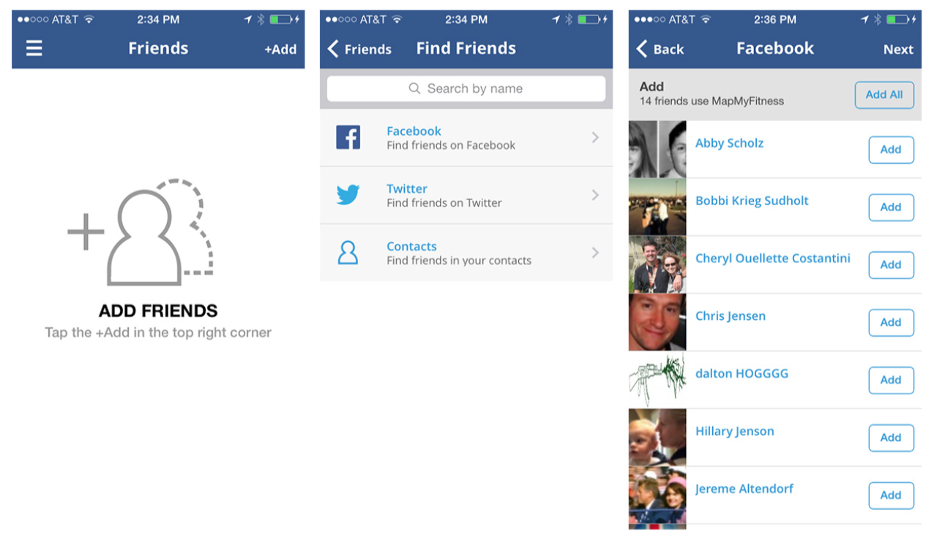
Notes:
FIGURE 8-5.
MapMyFitness for iOS: find friends from main menu
Looking again at MapMyFitness, I gave its Social Registration high marks for being short and sweet, but connections aren’t part of that flow. That’s not really an issue, though, because the app organically prompts for connection within normal user flows: from the main menu, through invitations before or after a workout, and through invi- tations in the Activity Feed.
Offer connection points throughout the application. It might make sense to offer connection opportunities during Registration, and/ or as part of one or more other user flows.

Slide 11
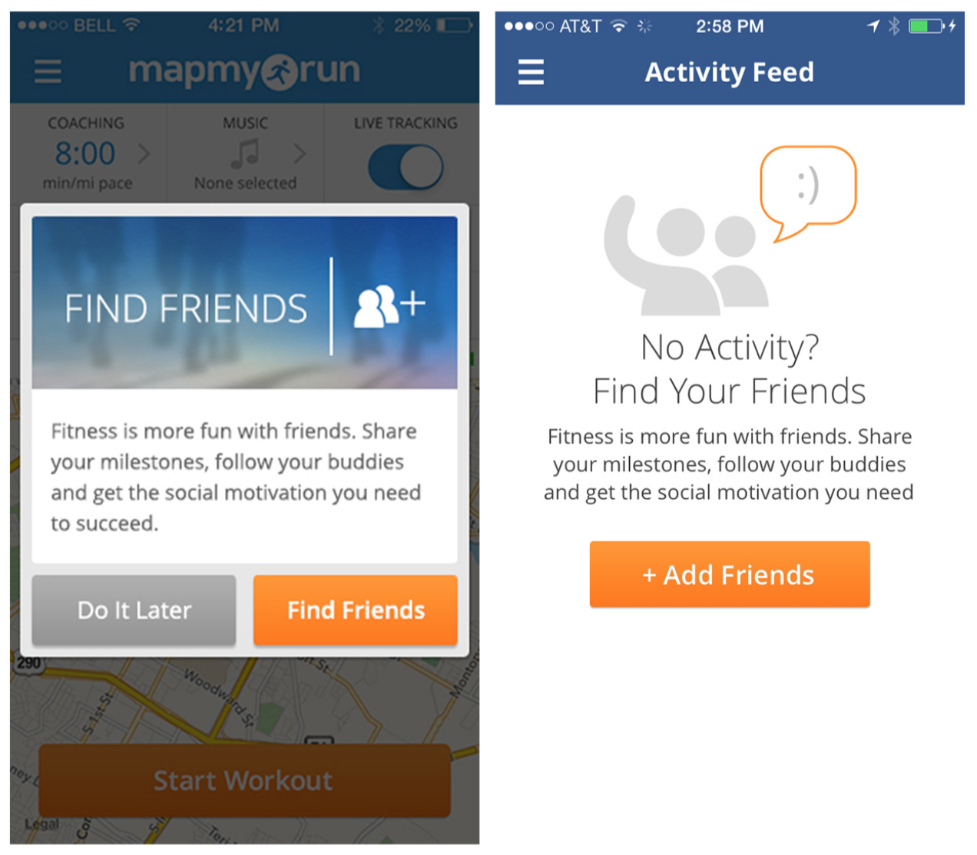
Notes:
FIGURE 8-6.
MapMyFitness for iOS: invitations to connect pre- or post-workout,
and in the Activity Feed

Slide 12
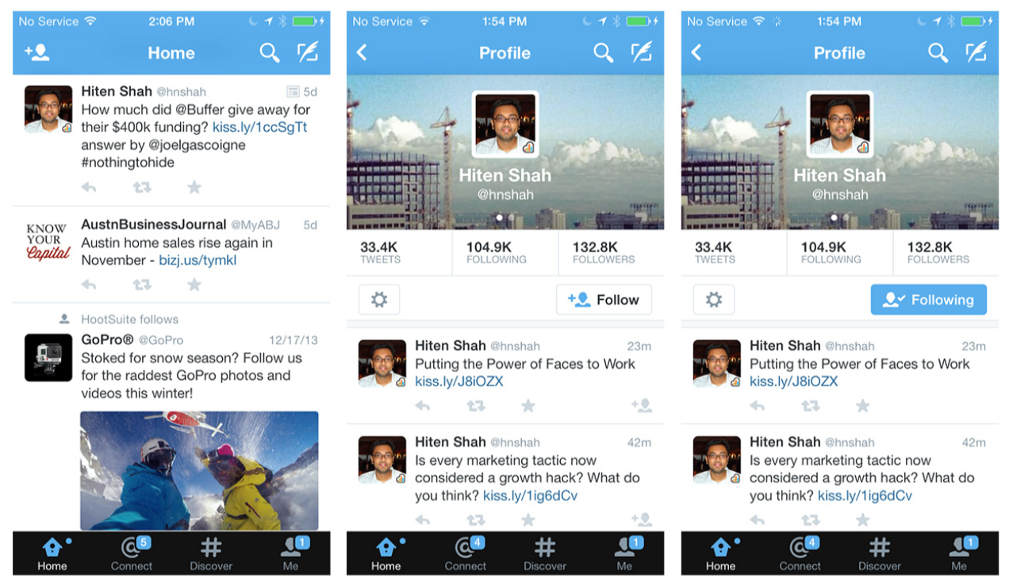
Notes:
FIGURE 8-7.
Twitter for iOS: the Following flow lets you see what else a user has shared
All of the previous examples show how to enable bulk connections. But you’ll probably also want to offer a one-to-one connection option. Thanks to Twitter, Following has become the generic term for this. In the Twitter and Zoomingo apps, the Following flow works like this: I’m browsing, I see something interesting (a tweet or a coupon), I look at who shared it, I check out what else that person has shared, and if what I see appeals to me I follow that person.

Slide 13
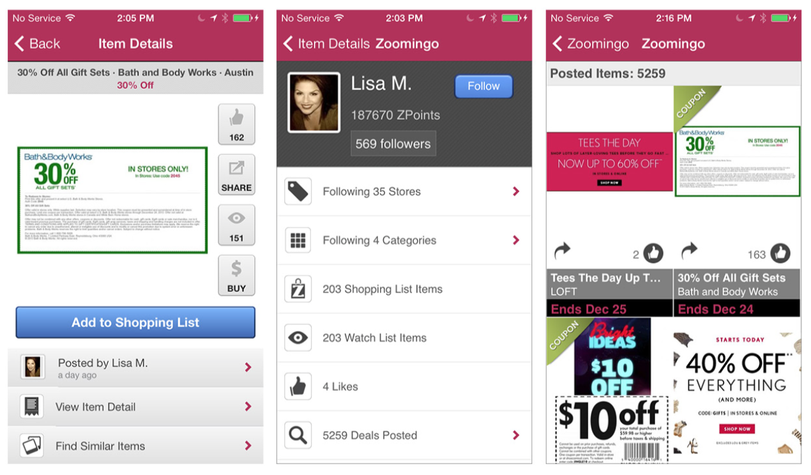
Notes:
FIGURE 8-8.
Zoomingo for iOS: the Following flow highlights the user’s reach within the network
\Offer Following at key points in the browsing flow to increase user engagement. Make the Follow button a prominent call to action on the Profile screen.

Slide 14
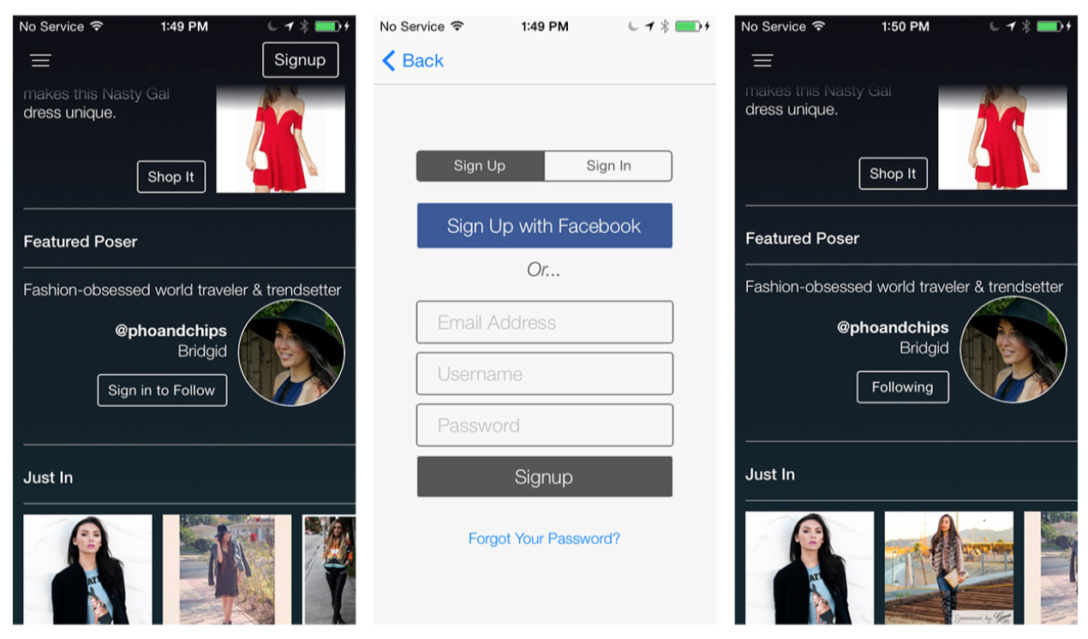
Notes:
FIGURE 8-9.
Pose for iOS: Featured Poser makes Following a conversion tactic
Pose makes Following a feature that drives signups. In its flow, the home page has a Featured Poser and a Follow call to action. If I want to see the Featured Poser’s collection and profile, I’ll need to register, if I haven’t already.

Slide 15
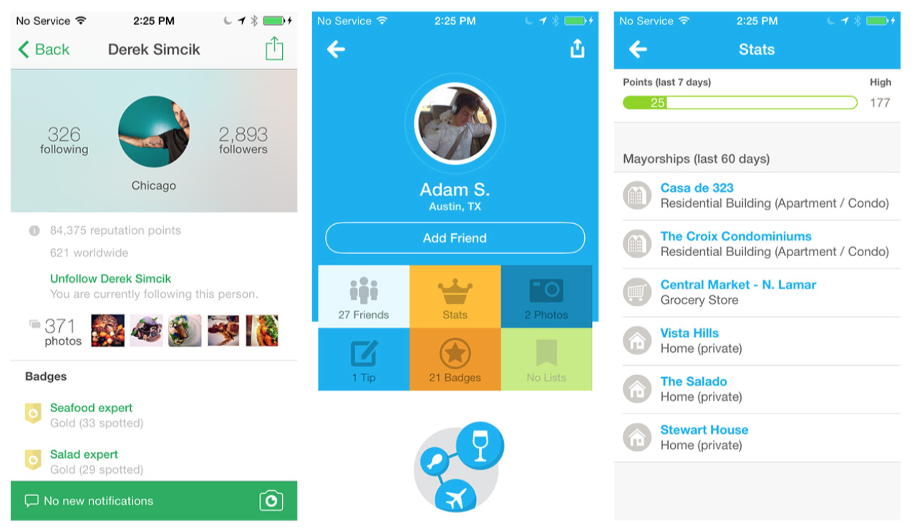
Notes:
FIGURE 8-10.
Foodspotting and Foursquare for iOS: statistics communicate engagement and reach
Although Profiles aren’t unique to social platforms, they are one of the key elements of all social networks. The best profile pages “introduce” the person with a photo, short bio, and lists of interests. They include an activity feed or another indicator of the profilee’s level of engage- ment, show that person’s reach (how popular, influential, or active she is in the network), and offer a way to follow, add, or otherwise connect with her.
Apps like Foodspotting and Foursquare use statistics to show how engaged the person is in the community. This makes sense, since the relationships in these two apps are based on credibility and trust.

Slide 16
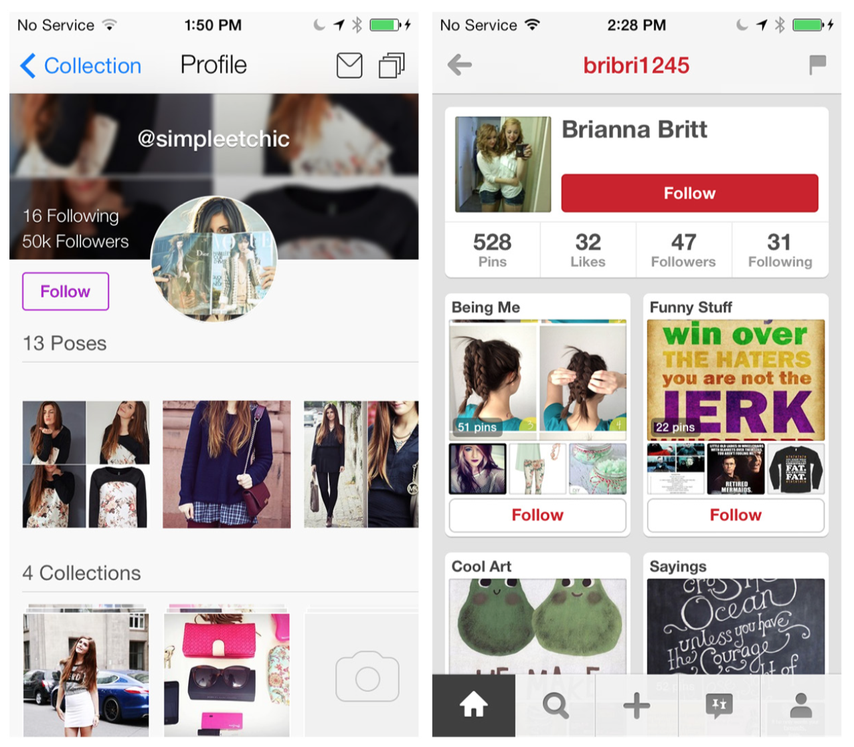
Notes:
FIGURE 8-11.
Pose and Pinterest for iOS: shared content is prominent in Profiles
Pose and Pinterest are more visual networks, based on members’ shared tastes. No surprise, then, that photos of shared content are the primary focus in their Profile screen designs.

Slide 17
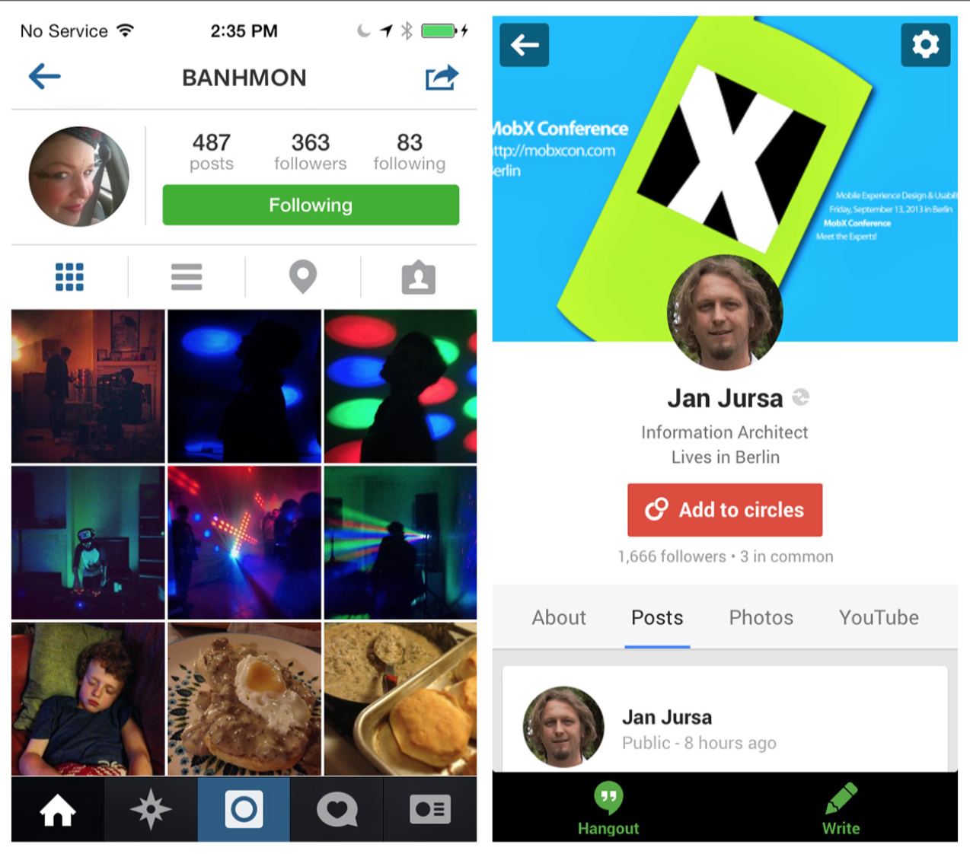
Notes:
FIGURE 8-12.
Instagram and Google+: tabbed Profiles
Sometimes a network touches so many aspects of a person’s life that a Profile can’t be limited to a single screen. Instagram and Google+ use tabs for the different facets of a Profile, whereas LinkedIn uses a list to drill into more details.
Profiles are the heart of social networks. Ultimately, the design should surface just enough information to make people want to connect with one another and build relationships within the network.

Slide 18
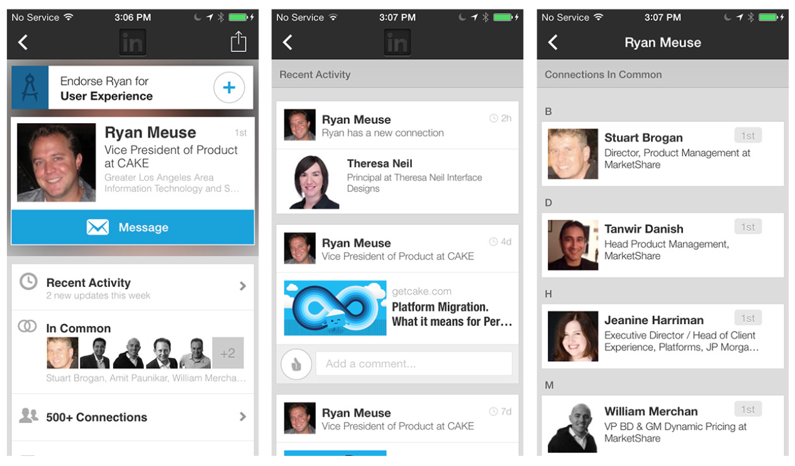
Notes:
FIGURE 8-13.
LinkedIn for iOS: list design for more Profile details

Slide 19
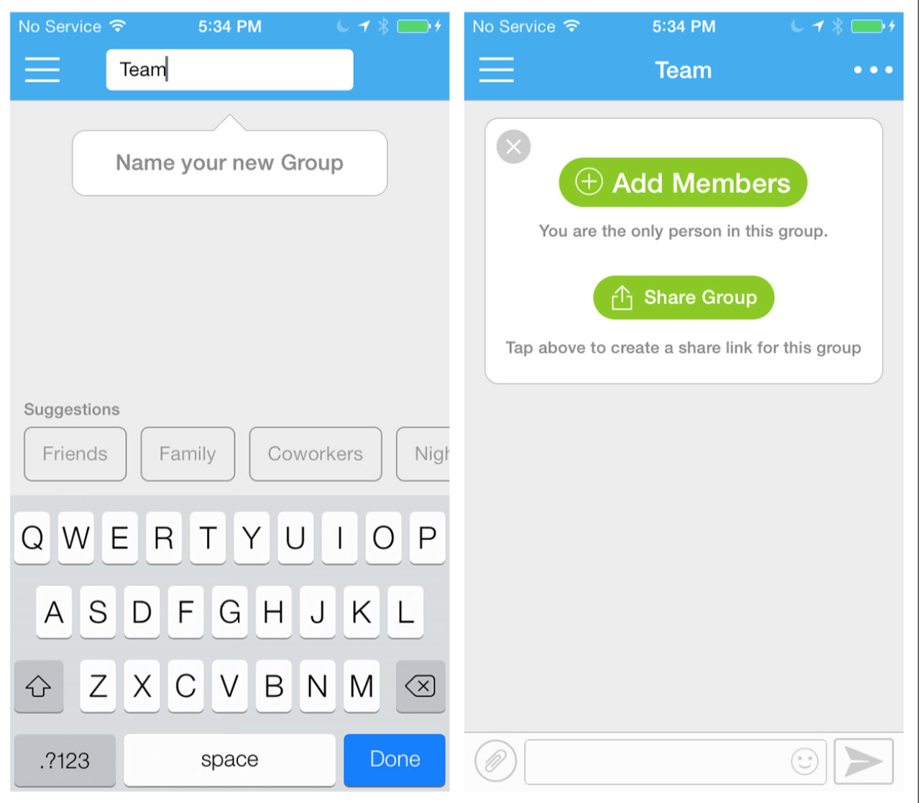
Notes:
FIGURE 8-14.
Group.me for iOS: dynamic search aids Group creation
Some Groups are implicit within social networks, while others need to be created by users. Group.me has a super simple interface for creat- ing a Group. Start with a Group name, and then use dynamic search to start adding contacts.

Slide 20
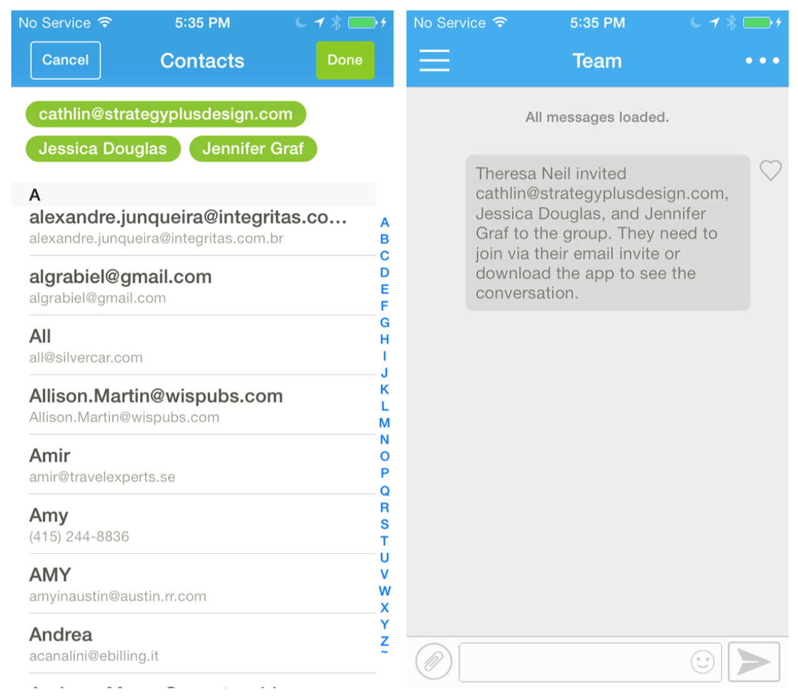
Notes:
FIGURE 8-14.
Group.me for iOS: dynamic search aids Group creation

Slide 21
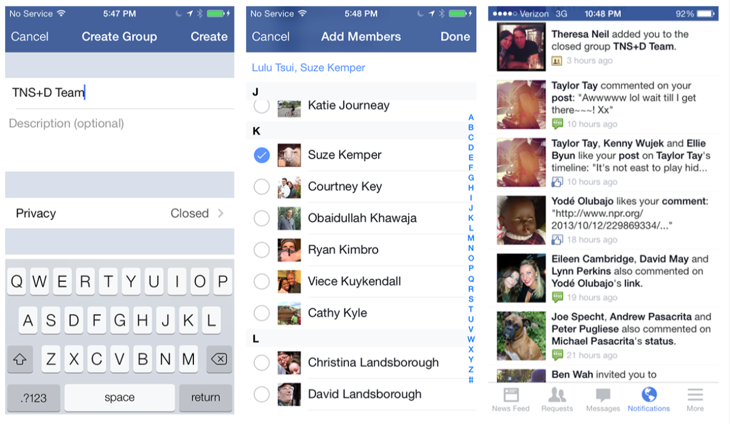
Notes:
FIGURE 8-15.
Facebook for iOS: create Group and add members, who then receive in-app notifications
Once added to the Group, an invitation will be sent to the members you selected. In this example from Facebook, my invitation appeared as an in-app notification.

Slide 22
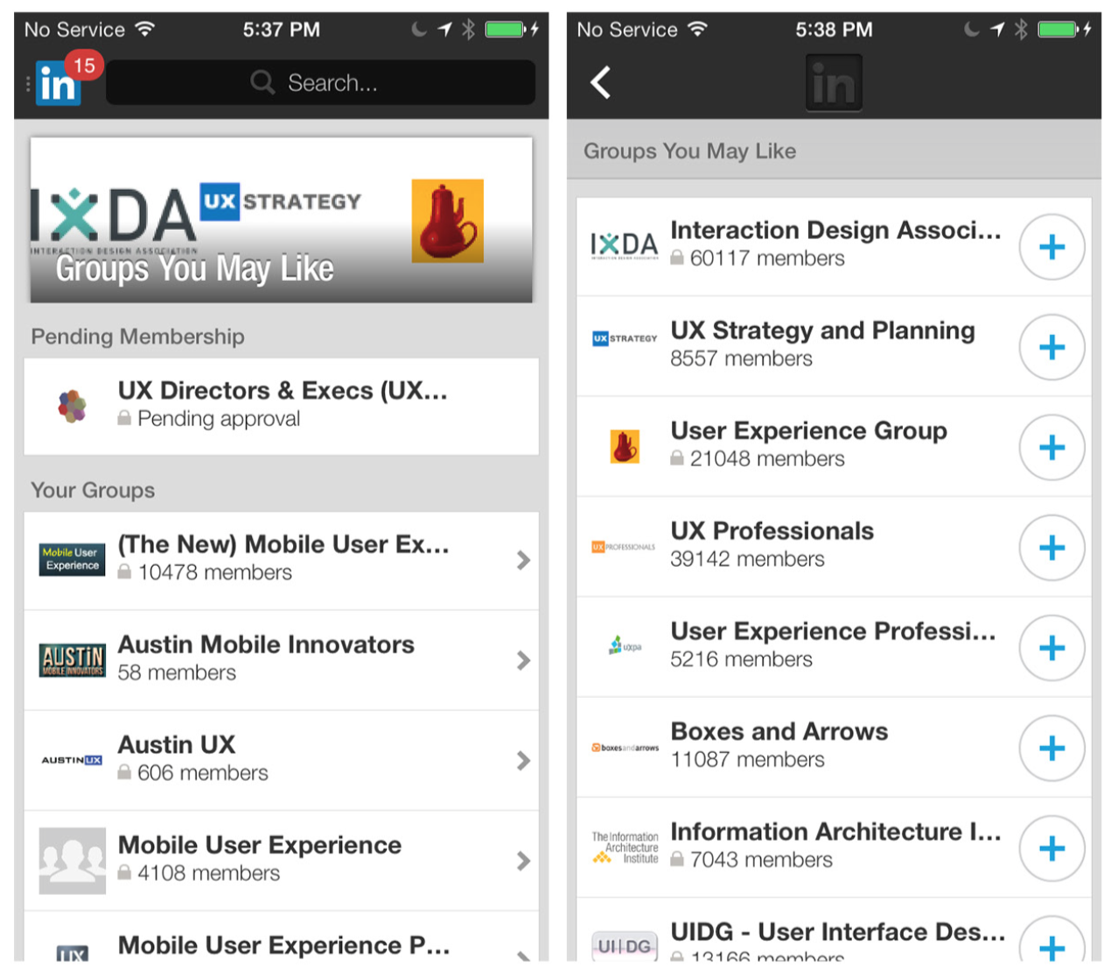
Notes:
FIGURE 8-16.
LinkedIn for iOS: a more formal process for joining Groups
LinkedIn provides recommendations for “Groups You May Like” and allows you to join a Group by tapping the + button. Many Groups require a Group administrator’s approval to join. In the example shown here, I added the Boxes and Arrows Group and received feed- back that my request was being processed. On my Profile page, I can easily access the 13 Groups I already belong to.
If your network relies on explicit Group creation, make the flow super easy and integrate the invitation into the application.

Slide 23
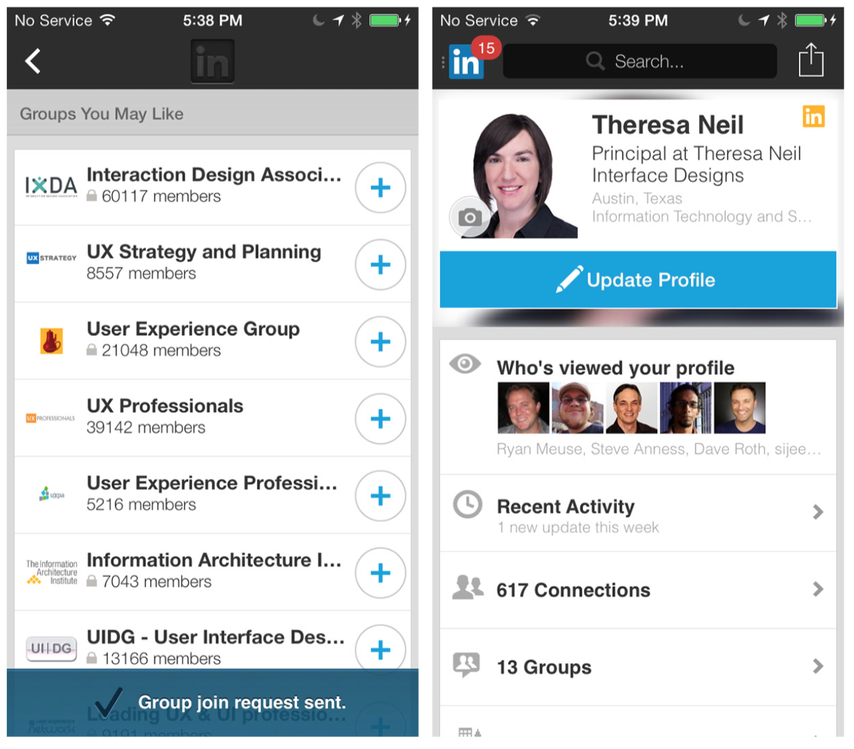
Notes:
FIGURE 8-16.
LinkedIn for iOS: a more formal process for joining Groups

Slide 24
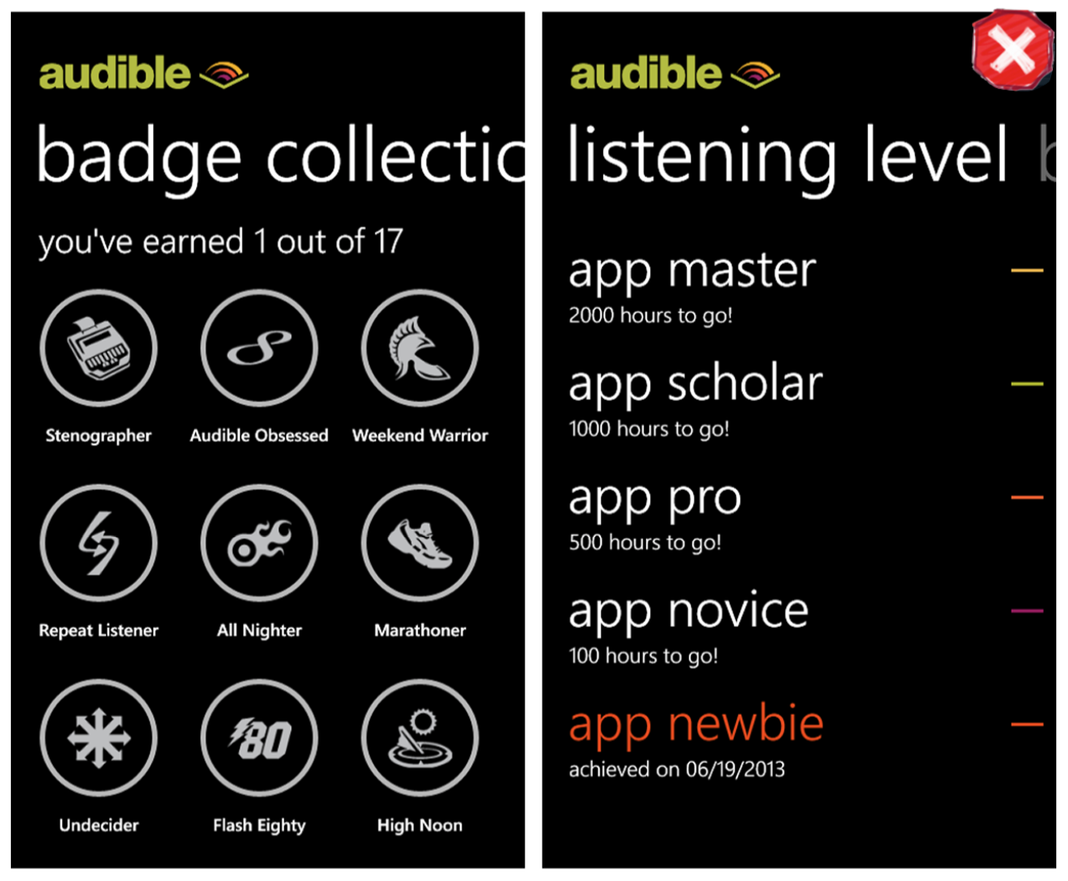
Notes:
FIGURE 8-17.
Audible for Windows Phone: a newbie despite long-term loyalty
It seems like everyone wants Gamification (game-like elements in a nongame) in their applications these days. What they really want is a sticky app—one that people return to time and again. But true Gamification takes more than offering a couple of badges. To under- stand the science and psychology behind Gamification, I highly recom- mend you read three books: Designing for Behavior Change, by Stephen Wendel (O’Reilly, 2013); How to Get People to Do Stuff, by Susan Weinshenk (New Riders, 2013); and Seductive Interaction Design, by Stephen Anderson (New Riders, 2011).
Beware: Gamification can backfire when implemented poorly. Let’s take a look at Audible and what I call the Forget-Me-Not anti-pattern. I’m a long time Audible subscriber, having purchased hundreds of audio books. I listen to Audible in my car, on my computer, at the gym, on a variety of devices. But despite my loyalty and longevity, look at my progress: I’ve got no badges and the app ranks me at the “newbie” level!
Why? Because this takes into account only what I have done with the mobile app on one particular device. With Gamification, it is critical to meet users’ expectations of interconnectivity and synchronization across devices.

Slide 25
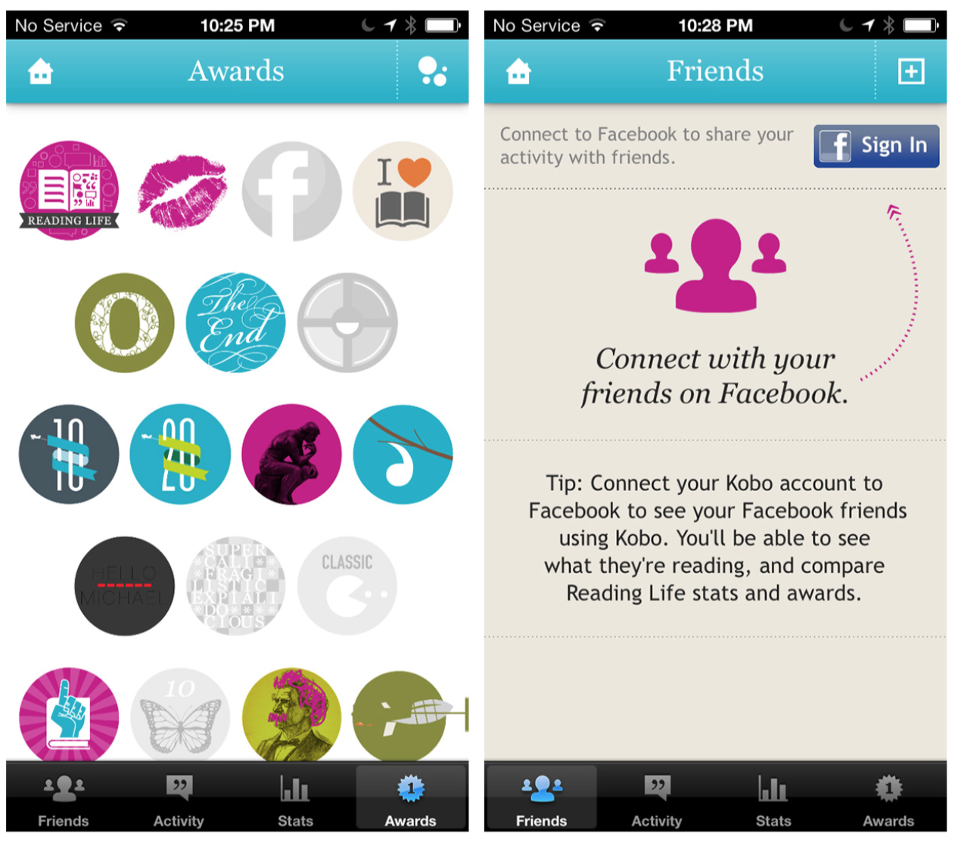
Notes:
FIGURE 8-18.
Kobo for iOS: Reading Life rewards work across platforms
Kobo does a nice job of this with its Reading Life pro- gram, and also integrates the Connecting design pattern.

Slide 26
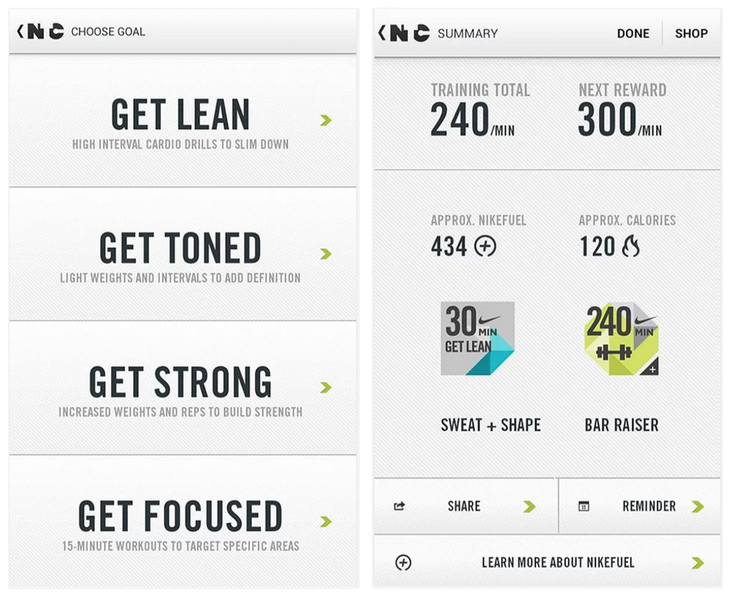
Notes:
FIGURE 8-19.
Nike Training Club for Android: meet self- specified goals, and get rewards
Nike Training Club has dialed back the badges but continues to offer rewards, which are tied directly to self-specified training goals.

Slide 27
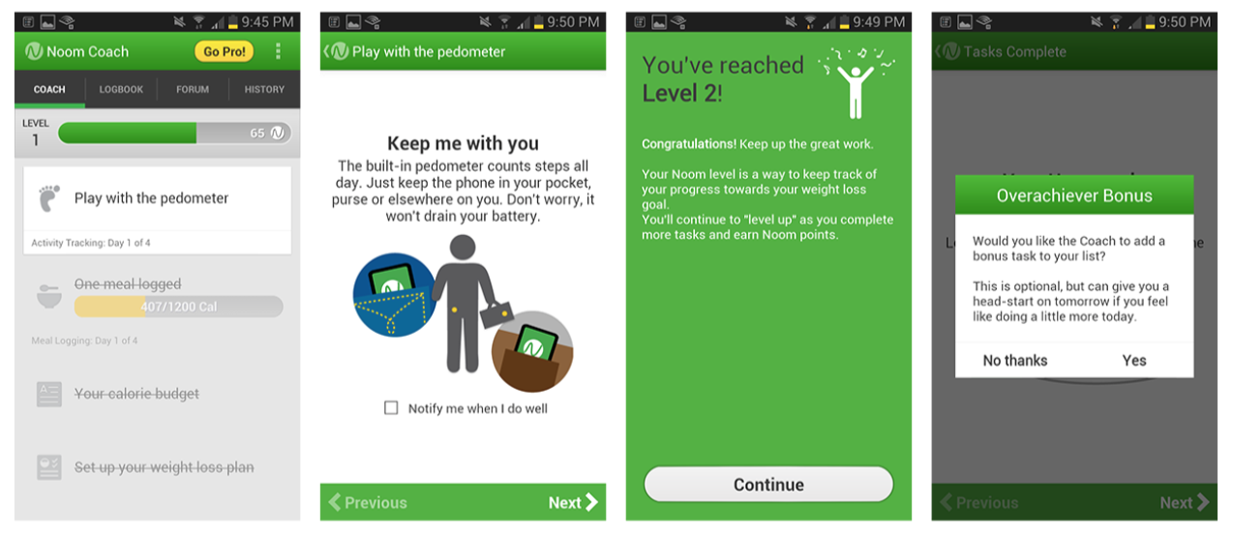
Notes:
FIGURE 8-20.
Noom for Android: leveling up and surprises “gamify” the experience
Noom uses the game concept of leveling up to encourage continued engagement and forward progress. It also uses a simple, well-known behavior modification technique: the element of surprise. Just as I completed the setup process, I was rewarded with an “overachiever bonus,” which inspired me to engage just a little more.

Slide 28
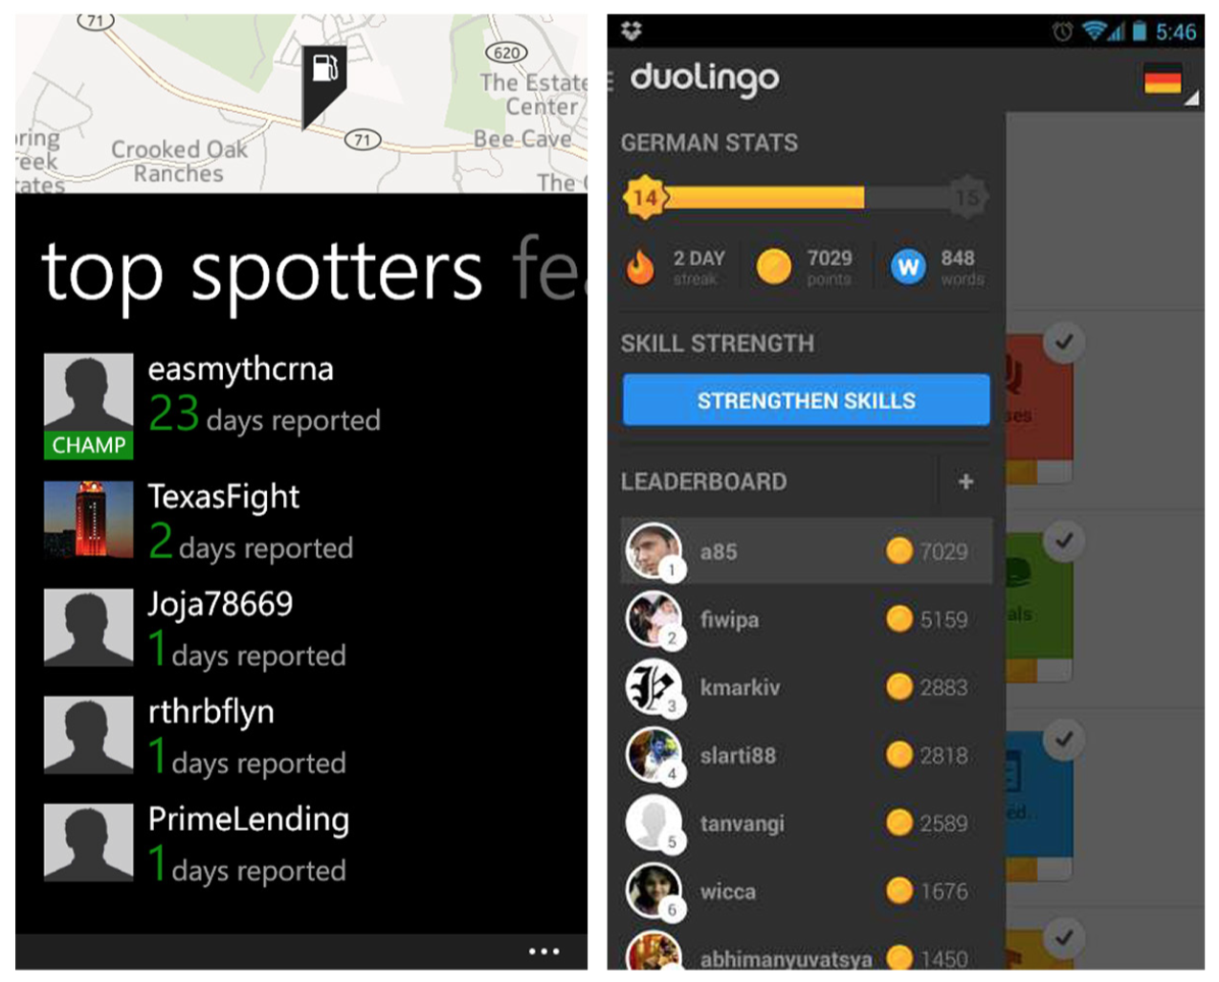
Notes:
FIGURE 8-21.
GasBuddy and Duolingo for iOS: Leaderboards and reputation Points
Other motivators in gamified apps include Leaderboards and Points. GasBuddy prominently features Top Spotters, and Duolingo shows stats for top performers.

Slide 29
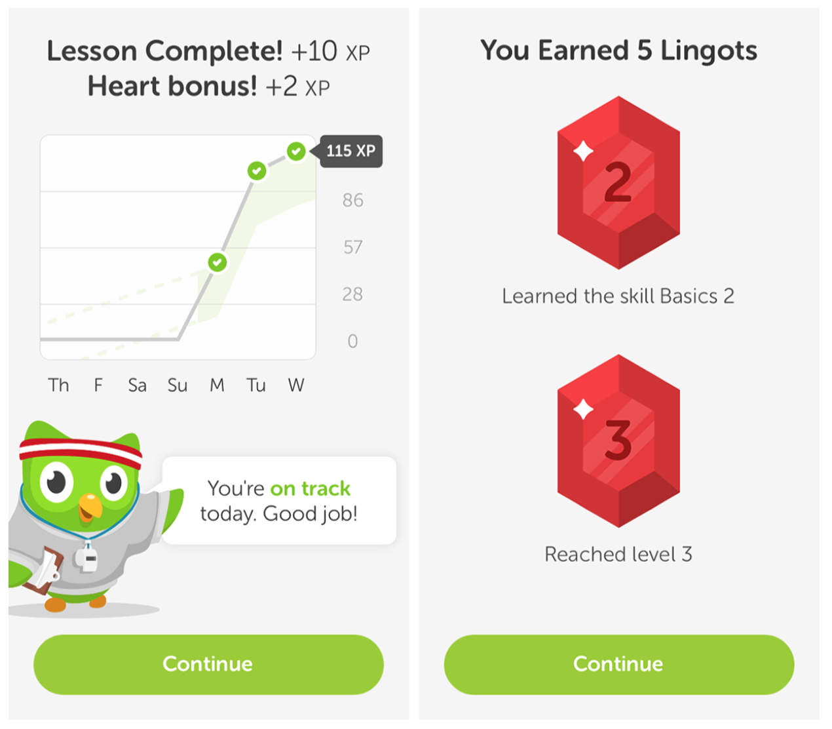
Notes:
FIGURE 8-22.
Duolingo shows progress against goals and rewards success with Lingots
With Duolingo, users earn “Lingots” for successfully completing a skill set. They can then use the Lingots for shopping—say, to purchase a new outfit for the cute little owl instructor.
Compare the simplicity of Duolingo to Foodspotting’s lengthy and confusing reputation system (http://www.foodspotting.com/about/ faq), where users have to earn points in order to award restaurants with blue ribbons (called “noms”). If you can’t explain the system in a sentence or two, it may be too complex to motivate users as much as you’d like.
Understand the principles of Gamification and behavior change before trying these patterns. Keep it simple and fun, and don’t force Gamification where it isn’t appropriate.

Slide 30
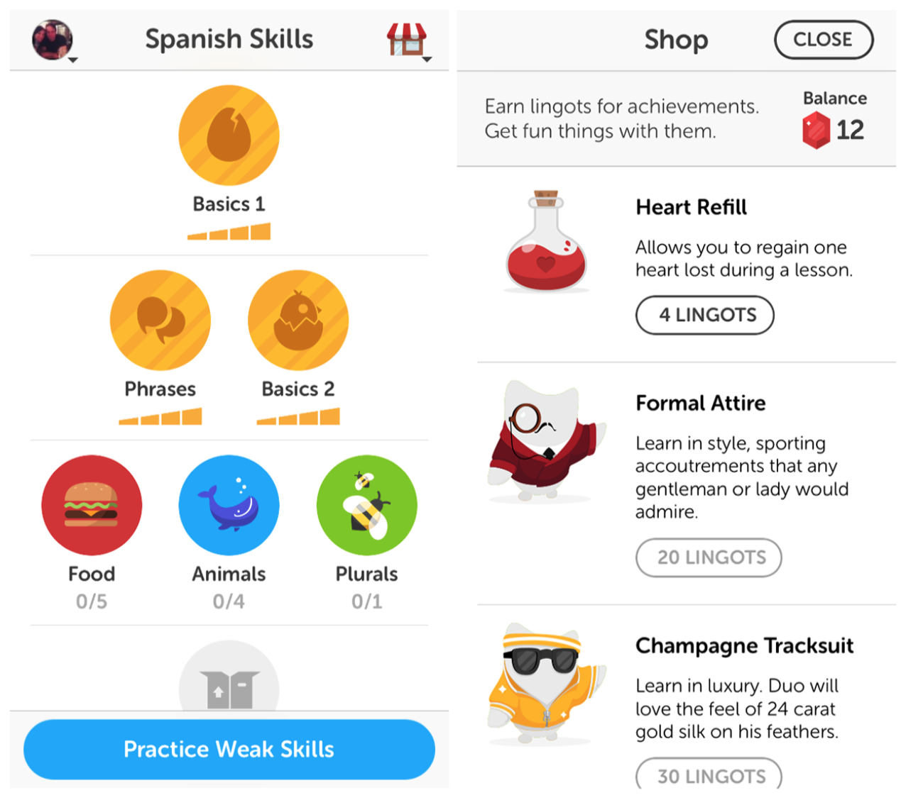
Notes:
FIGURE 8-22.
Duolingo shows progress against goals and rewards success with Lingots

